Slide 1
IOT BASED WATER DISPENSER FOR PLANTS
Under guidance of
Dr. LAKSHMANAPRAKASH S,
Assistant Professor,
BIT,
Sathy.
202IT185 - OSCAR A
202IT223 – SOURAV H
202IT126 - DEVADHARSHAN R
202IT111 – ARUN K

Slide 2
Abstract
In daily operations related to farming or gardening watering is the most important practice and the most labour-intensive task. No matter whichever weather it is, either too hot and dry or too cloudy and wet, you want to be able to control the amount of water that reaches your plants. Modern watering systems could be effectively used to water plants when they need it. But to implement this there are two major tasks i.e., Amount of water to be poured and the time to be poured. In order to replace manual activities and making gardener's work easier, we have created automatic plant watering system. By this method we can water our plants by calculating the moisture content in the soil and water our plants manually or automatically by using a mobile application. By adding automated plant watering system to the garden or agricultural field, you will help all of the plants reach their fullest potential as well as conserving water. Using sprinklers drip emitters, or a combination of both, we have designed a system that is ideal for every plant in the yard. To note the moisture content in the soil we have used sensor that will detect the amount of water in the soil.

Slide 3
Abstract Cont.
In this sensor we have pre-determined the moisture content according to the plant. If it reaches below that level the motor starts running and waters the plant it also sends a mobile notification to our mobile application. The motor runs till the moisture content of the soil reaches up to that pre-determined amount. This moisture content can be monitored by our mobile phone and by our mobile phone we can water our plants. Generally, plants need to be watered twice a day, morning and evening. Thus, the microcontroller is programmed to water plants two times per day. System is designed in such a way that it reports its current state as well as remind the user to add water to the tank. All these notifications are made through mobile application. We hope that through this prototype we all can enjoy having plants, without being worried about absent or forgetfulness.

Slide 4
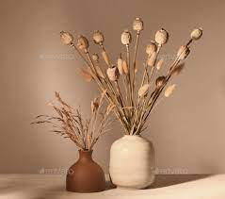
Problem Statement
Every plant and tree in our earth need water.
Water is essential for all living organisms.
In this technological world, People are busy with their tight schedule .They don’t have enough time to take care their plants and trees.
Due to this plants get dry and lose their lives.

Slide 5
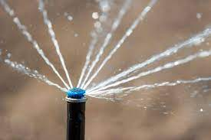
Existing Solution to the Problem Addressed
There is already a solution that will pour water for the plants by manual control but the difference is that our device will automatically pour water for the plants and trees by remote access.

Slide 6
Proposed Solution to the Problem Addressed
To overcome these issues in plants we have introduced an Automatic water dispenser for plants which is controlled by a mobile application.
We have to insert a moisture sensor in the soil near the roots of the plant to measure the moisture content in the soil.
If the moisture content in the soil reaches a predetermined level it will need to send a notification to the user.

Slide 7
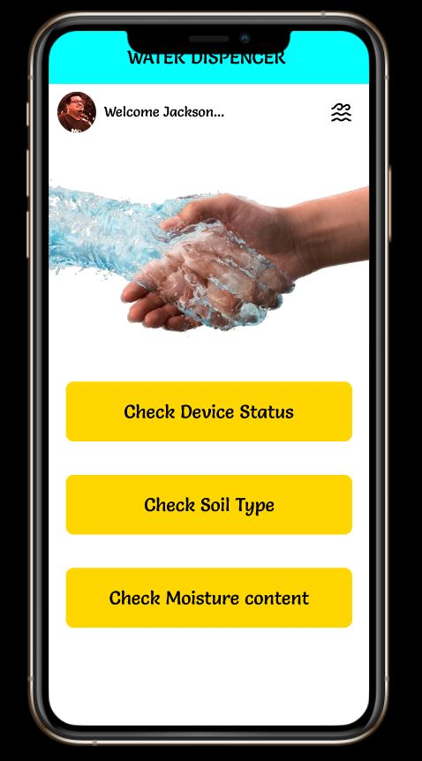
Project Work Plan
The sensor is placed inside the soil.
It will measure the moisture content every time.
It sense the required amount of water.
If yes, the Arduino in which program is burned starts the motor.
Once the water content in the soil reaches below predetermined level it will send a notification.
If the user didn’t respond for a time of 10 mins it will automatically pour the water.

Slide 8
Block Diagram
VERIFY THROUGH OTP
SET MINIMUM MOISTURE LEVEL
MOBILE APP
CONNECT TO DEVICE
NOTIFY
WATER AUTOMATICALLY
GET DETAILS OF SOIL

Slide 9
Effective utilization of the Modern Tool & Cloud
So far , We have designed a prototype for this idea. We are planning to implement this idea as an app. We are going to build this app using flutter.
We are going to work on the platform called Microsoft azure. We selected Microsoft azure because it has more benefits than other cloud platforms.

Slide 10
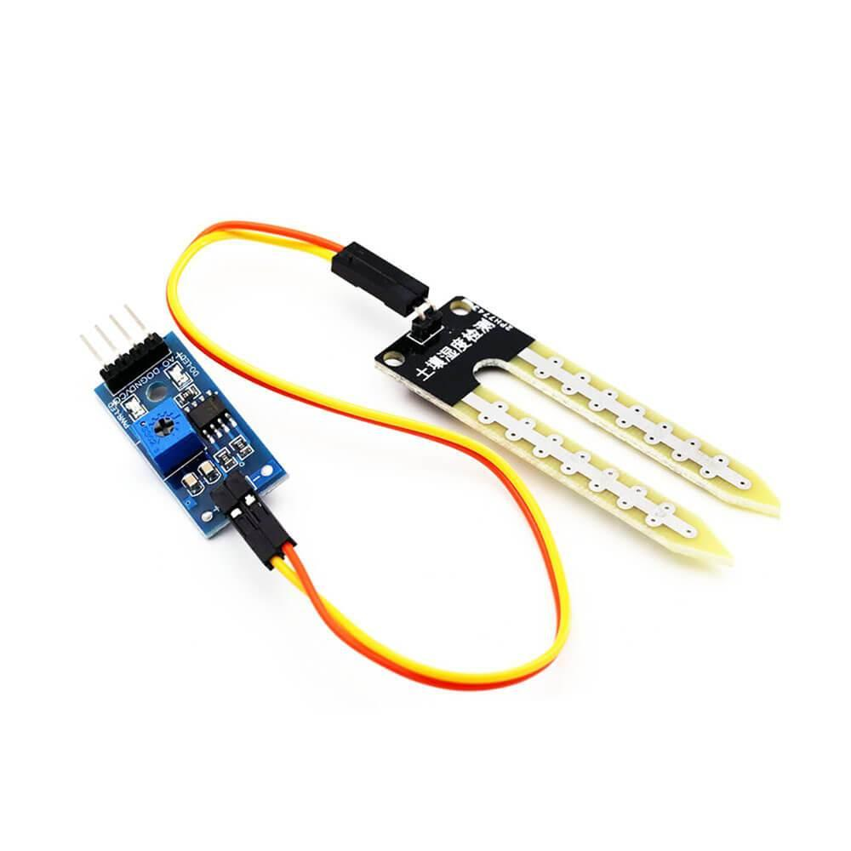
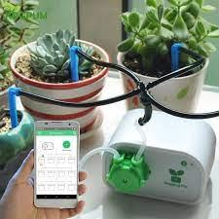
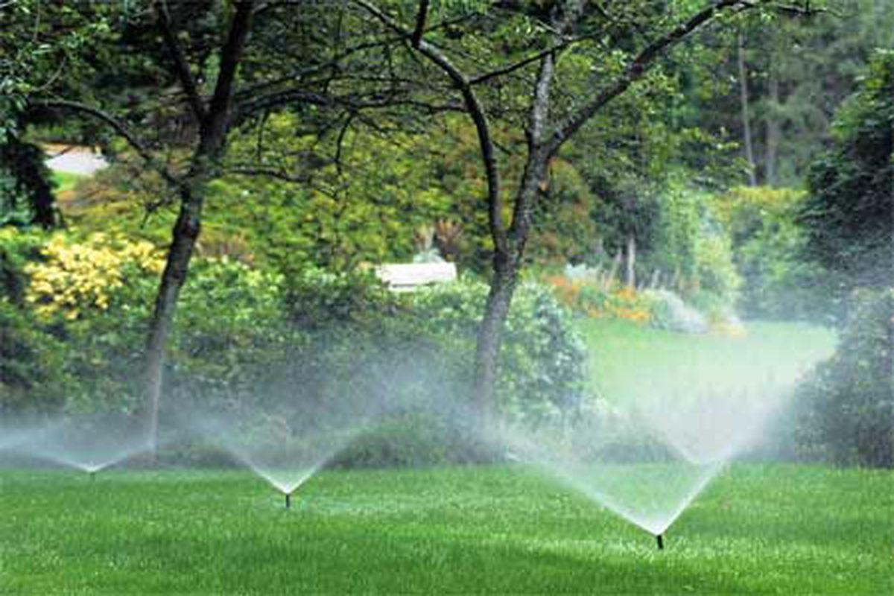
Technology stack & use case
Arduino UNO R3 board
Arduino IDE (Program the Arduino)
Soil moisture sensor module (Measure the moisture)
Wifi Module for Arduino
Servo motor
Flutter or Android Studio (To create an mobile application)
Relay module

Slide 11
Prototype & Sample Output
Prototype link:
https://www.figma.com/proto/XrV9YytZ55awv0YjJwcWal/Pico-Zen-team-library?page-id=0%3A1&node-id=411%3A2&viewport=-442%2C254%2C0.17292332649230957&scaling=scale-down&starting-point-node-id=411%3A2

Slide 12
Analysis of Results & Discussions
In this technological world people used to buy plants to keep them away from mental distractions, Stress, Depressions in work etc...
Often, they have no time to take care of them and forget to water them. Due to this these plants get sick and gets dried.
To avoid these things, they can use this Automatic Water dispenser to water them on time and keep them healthy and happy.
This prototype can be used to dispense water at the right time by inputting the predetermined amount of moisture content.
The moisture level for different types of soils are adjustable and can be changed accordingly.
When the user gets a notification in his mobile phone he can water the plant or the device itself pours water accordingly.

Slide 13
Cost Benefit Analysis (List of Components / Service Used)
(Budget)
S.No | Component Name | Unit Cost | Total Cost
1. | Arduino UNO R3 board | 500 | 500
2. | Relay Module | 150 | 150
3. | Soil moisture sensor module | 250 | 250
4. | Servo motor | 200 | 200

Slide 14
Working video Link
Video link:
https://drive.google.com/file/d/10Ijxx9KmKw8zYRaCo69QkuiPuN5kf7Dl/view?usp=sharing

Slide 15
References
BezaNegashGetu, Hussain A. Attia;“Automatic Water Level Sensor and Controller System”,Electronic Devices, Systems and Applications (ICEDSA), 2016 5th International Conference on ,ISSN: 2159-2055
Thinagaran Perumal, Md Nasir Sulaiman&Leong.C.Y ,“Internet of Things (IoT) Enabled Water Monitoring System”,2015 IEEE 4th Global Conference on Consumer Electronics (GCCE),ISBN: 978-1-4799-8750-4
Nicola Ivan Giannoccaro, Luigi Spedicato;”Ultrasonic Sensors for Measurements of Liquid Level, Volume and Volumetric Flow in a Tank”,Volume 1, Issue 1 April 2012 ,ISSN: 2159-2055

